Slide 1
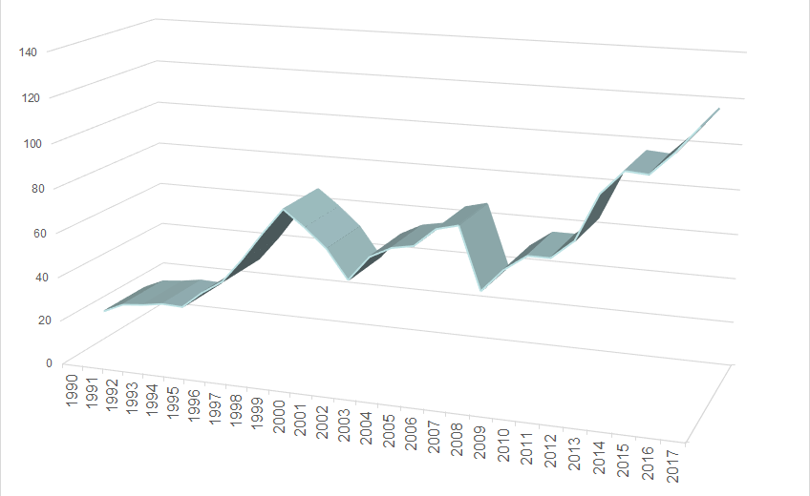

Homework 01
Daily return on the S&P500 are available for 66.0 years
In 2015, Takata Corp. reported hydroburst pressure values for ten of its airbags

Slide 2
1. Year with most days showing an increase?
2. CAGR for the S&P500?
3. Year with the longest “up run”?
4. How many “up runs” were exactly 3 days?
5. Number of years with net increase in value?
Homework 01
Daily return on the S&P500 are available for 66.0 years

Slide 3
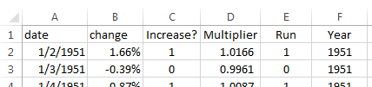
Use Excel
Create new columns; create pivot table
Set to 1, since no previous
=1*(B3>0)
=1+B3
=YEAR(A3)
=IF(C3=1,E2+1,0)

Slide 4





Question | Excel method | Answer
1. Year w/ most days w/ increase? |  | 1995
2. CAGR for the S&P500? |  | 7.38%
3. Year with the longest “up run”? |  | 1971
4. How many “up runs” = exactly 3? |  | 589
5. # of years with net increase? |  | 48

Slide 5

1. Year with most days showing an increase?
a. Use pivot table
(sum) to count # of
increases, by year
b. Find year with largest value from pivot table
2. CAGR for the S&P500?
By definition: from original data, compute value at
end of 66 years, take 66th root, subtract 1

Slide 6

3. Year with the longest “up run”?
a. Use pivot table to find
max “run” value by year
b. Find year with largest max value from pivot table
4. Number of “up runs” exactly 3 days long?
a. Use pivot table to find
distrib. of “run” values
b. “# with exactly 3” can be found by computing
“# with 3 or more” minus “# with 4 or more”

Slide 7

5. Number of years with net increase in value?
a. Use pivot table to find
value each year (take
product of multipliers)
b. Use =COUNTIF( [..], “>1”) to count number of
years that have net end-of-year value > 1.0

Slide 8
Homework 01
In 2015, Takata Corp. reported hydroburst pressure values for ten airbags
6. Z-value for operating pressure?
7. Allow use of ~65 million Takata airbags?
8. Most significant effect of altering the data?
9. Allow the use of ~65 million Takata airbags?
10. Operating pressure for risk < 10^{–9}?

Slide 9
6. Z-value for operating pressure?
 = 79.78, SD = 1.04,
Z = (62.23–79.78)/1.04 = –16.8
7. Allow use of ~65 million Takata airbags?
If normally distribution and Z = –17, allow use; risk is negligible
8. Most significant effect of altering the data?
SD was underestimated (correct SD = 4.61, not 1.04) … this has large effect on tail probabilities

Slide 10
9. Allow the use of ~65 million Takata airbags?
Based on new data, no:
Z = (62.23 – 79.74) / 4.61 = –3.78
→ p = 7.33 x 10^{–5}
→ 5199 ruptures out of 65 million airbags
“In June of 2015, Takata stated [there had been] 88 ruptures in … 1.2 million airbag deployments spread over 15 years”
88 / 1.2 million = 7.33 x 10^{–5}
10. Operating pressure for risk < 10^{–9}?
Desired p = 1e-9 → Z = –5.998
→ pressure = 79.74 – 5.998(4.61) = 52.1 MPa

Slide 11
Any questions?
Daily return on the S&P500 are available for 66.0 years
In 2015, Takata Corp. reported hydroburst pressure values for ten of its airbags

